Slide 1
BigData
Different Aspects of Complexity

Slide 2
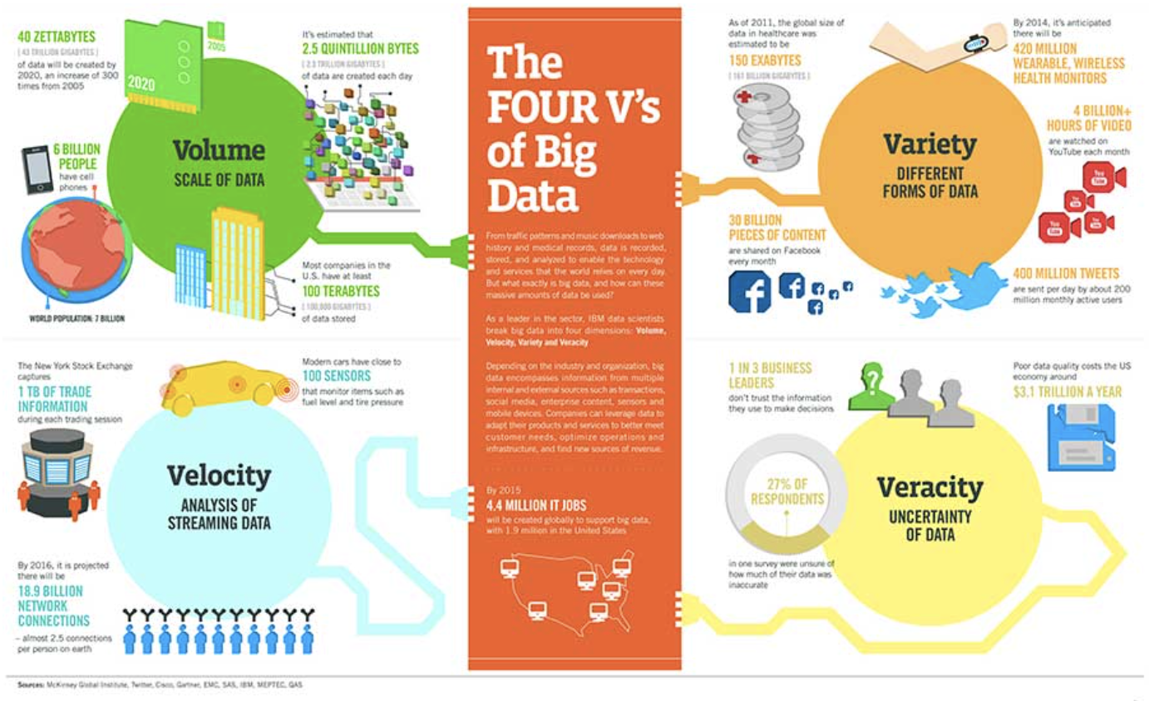

Slide 3
IT Architectures
BigData
Machine Learning

Slide 4
Raw data

Slide 5
Raw data
Data extraction

Slide 6
Raw data
Data extraction
Data analysis

Slide 7
Raw data
Data extraction
Data analysis
Data preparation

Slide 8
Raw data
Data extraction
Data analysis
Data preparation
Model training

Slide 9
Raw data
Data extraction
Data analysis
Data preparation
Model training
Model evaluation

Slide 10
Raw data
Data extraction
Data analysis
Data preparation
Model training
Model evaluation
Model validation

Slide 11
Raw data
ML
Data extraction
Data analysis
Data preparation
Model training
Model evaluation
Model validation
Trained model
Model registry

Slide 12
Raw data
ML
Data extraction
Data analysis
Data preparation
Model training
Model evaluation
Model validation
Trained model
Model registry
Prediction service

Slide 13
Raw data
ML
Data extraction
Data analysis
Data preparation
Model training
Model evaluation
Model validation
Trained model
Model registry
Performance monitoring
Prediction service

Slide 14
The whole proces is supported by repositories and CI/CD systems
Feature store
Experiment tracking
Model registry
Raw data
Data extraction and analysis
Data preparation
Model training
Model evaluation and validation
Trained model
Infrastructure monitoring
Model monitoring
CI/CD

Slide 15
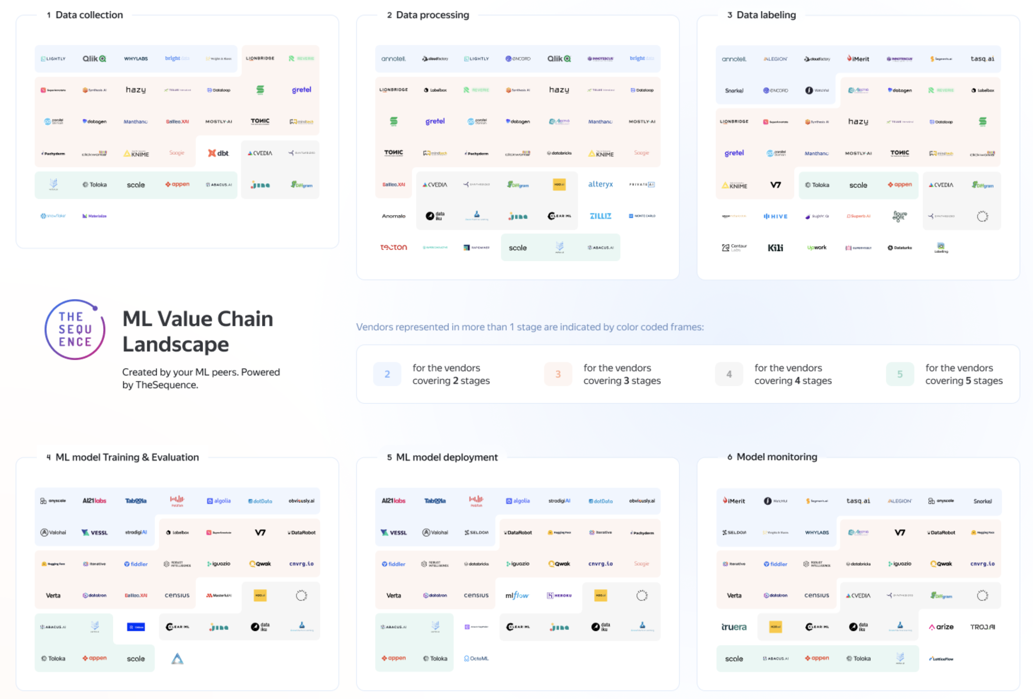

Slide 16
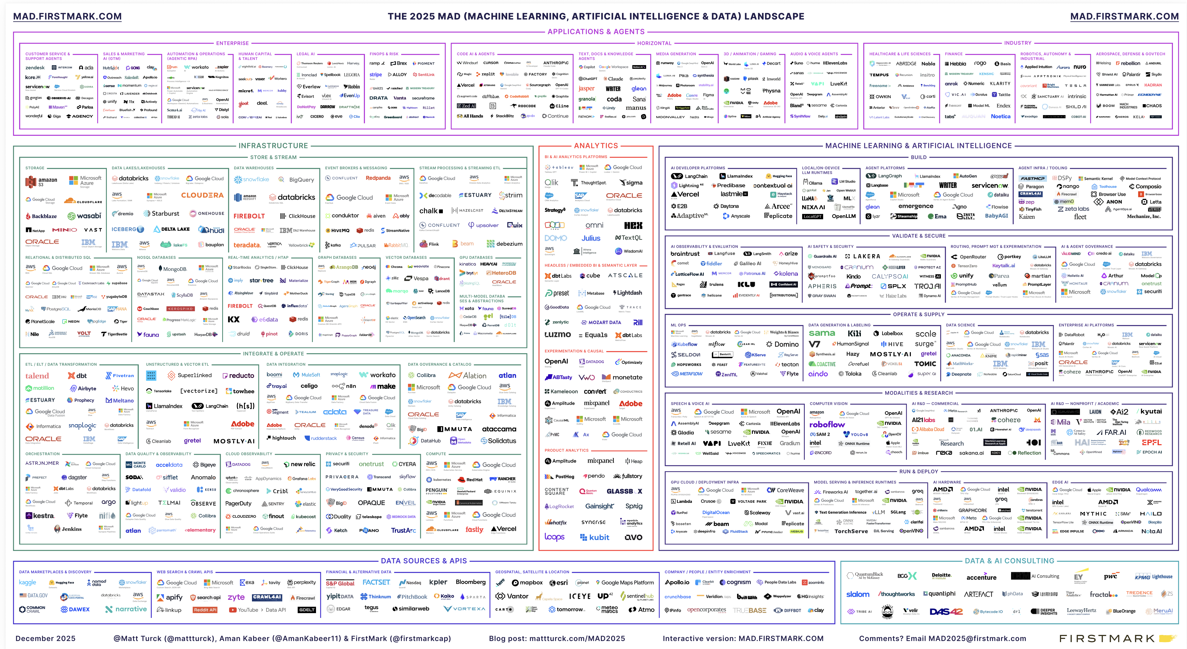

Slide 17
Complexity: data
Complexity: models
Complexity: deployment
Complexity: performance
Complexity: changes

